Slide 1
Predicting Company Profitability: Regression Analysis of R&D Spend, Administration Costs, and Marketing Spend
Presented by: Ashutosh Mishra
Xavier University, School of Computer Science & Engineering

Slide 2
Table of Contents
Abstract
Introduction
Dataset Overview
Objectives
Methodology
Implementation
Results and Interpretation
Conclusion
Key Findings
Limitations and Future Directions

Slide 3
Abstract
Analysed a dataset of 50 startups with variables: R&D Spend, Administration Costs, Marketing Spend, and Profit.
Developed regression models to predict profit.
Techniques: Linear Regression, Gradient Boosting Regression, Decision Tree Regression.
Metrics: Mean Squared Error (MSE), Mean Absolute Error (MAE), R-squared (R²).

Slide 4
Introduction
Dataset contains information on 50 startups.
Variables: R&D Spend, Administration Costs, Marketing Spend, Profit.
Objective: Explore the relationship between spending patterns and profit.

Slide 5
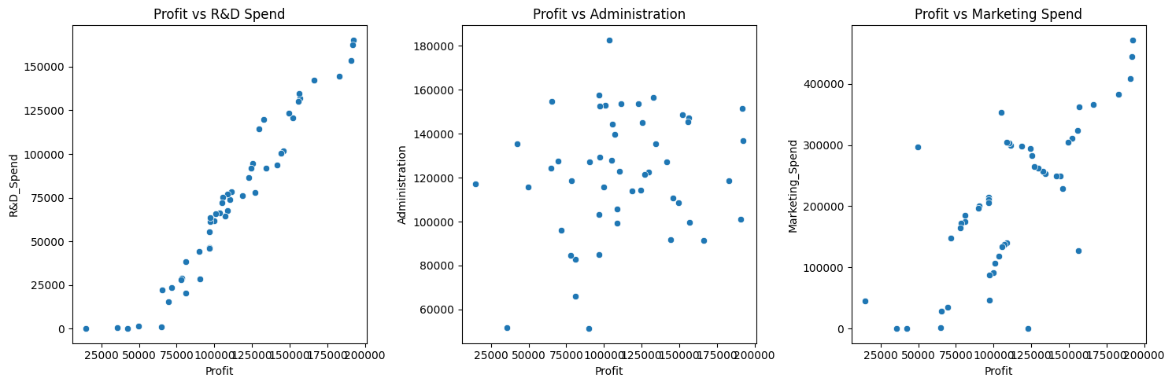
Relationship between spending patterns and profit

Slide 6
Dataset Overview
R&D Spend: Investment in innovation and product development.
Administration: Expenditure on administrative tasks.
Marketing Spend: Financial resources allocated to marketing efforts.
Profit: Net profit earned by each startup.
 | R&D_Spend | Administration | Marketing_Spend | Profit
Count | 50.00000 | 50.00000 | 50.00000 | 50.00000
Mean | 73721.615600 | 121344.639600 | 211025.097800 | 112012.639200
Std | 45902.256482 | 28017.802755 | 122290.310726 | 40306.180338
Min | 0.000000 | 51283.140000 | 0.000000 | 14681.400000
25% | 39936.370000 | 103730.875000 | 129300.132500 | 90138.902500
50% | 73051.080000 | 122699.795000 | 212716.240000 | 107978.190000
75% | 101602.800000 | 144842.180000 | 299469.085000 | 139765.977500
Max | 165349.200000 | 182645.560000 | 471784.100000 | 192261.830000

Slide 7
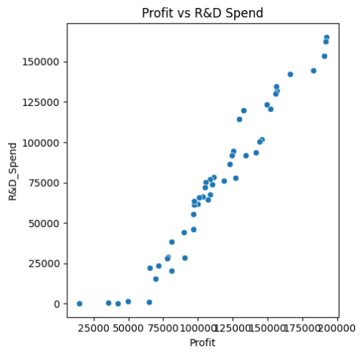
Objectives
Develop regression models to predict startup profit based on spending patterns.
Multiple Linear regression
Gradient Boosting Regression
Decision Tree Regression
Most influential factors contributing to startup success is “R&D spend”

Slide 8
Methodology
Data Preprocessing:
Handle missing values: missing values can be replaced by mean, mode of the data
Scale features: feature is scaled using standardization
Split data into training and testing sets.
Regression Modelling:
Linear Regression
Gradient Boosting Regression
Decision Tree Regression.
Model Evaluation Metrics:
MSE
MAE
R²

Slide 9
Implementation
Data Preprocessing:
Handle missing values: There are no missing values
Scale features: Features scaled using “StandardScaler” function
Split dataset: Split the data in 80% training and 20% testing.
Model Training: Multiple Linear Regression, Gradient Boosting Regression, Decision Tree Regression.
Model Evaluation: Use MSE, MAE, R².

Slide 10
Results and Interpretation
Compare model performances.
Metrics of Multiple Linear Regression model is:
MSE: 0.020744206029190554, MAE: 0.1318548053584457, R2': 0.9827789020862663
Metrics of Gradient Boosting Regression model is:
MSE: 0.06590558925493431, MAE: 0.18819564950624237, R2: 0.9452875369621543
Metrics of Decision Tree Regression model is:
MSE: 0.02348896007247095, MAE: 0.125096354475731, R2: 0.9805003054476706
Best performing model is Multiple Linear Regression with 98.27% accuracy
Conduct feature importance analysis.

Slide 11
Conclusion
Regression modeling provides insights into predicting startup profits.
Understanding spending patterns can guide strategic decisions.
Effective regression techniques capture relationships between variables.

Slide 12
Key Findings
Best Performing Model: Multiple Linear Regression
Achieved: Highest R² value (0.9827) for Multiple Linear Regression on testing dataset.
Feature Importance: Identified most influential features on profitability.
Practical Implications: Model provides actionable insights for stakeholders.

Slide 13
Limitations and Future Directions
Dataset Limitations: Limited sample size, lack of additional features.
Model Refinement: Continuous optimization, explore advanced techniques, incorporate more data.

